Slide 1

AI/ML Government-Wide Implementation
Executive Program Overview: Strategic deployment of artificial intelligence and machine learning capabilities across Abu Dhabi government entities with comprehensive risk management framework

Slide 2

Program Scope & Strategic Objectives
Implementation Goals
Success Criteria
Deploy enterprise-grade AI/ML capabilities across government departments, focusing on Arabic language processing, citizen services automation, and intelligent decision support systems.
95% Arabic NLP accuracy achieved
Zero critical security incidents
30% improvement in service processing time
Full regulatory compliance maintained
Target deployment: 15 government entities in 18 months with phased rollout strategy

Slide 3
Project Timeline & Critical Milestones
Phase 1: Foundation
Phase 3: Scale
Months 1-4
Months 11-15
Infrastructure setup, governance establishment, initial ERP integration, pilot department selection
Government-wide rollout, performance optimization, advanced feature activation, training completion
1
2
3
4
Phase 2: Core Build
Phase 4: Optimize
Months 5-10
Months 16-18
Arabic NLP model training, primary system integrations, security framework deployment, user acceptance testing
Full production operations, continuous improvement, knowledge transfer, transition to support model
Critical Path: ERP integration completion (Month 4) is prerequisite for Arabic NLP deployment. Infrastructure security certification must complete before Phase 2 initiation.

Slide 4
Top 5 Program Risks & Mitigation
ERP System Integration Delays
Arabic NLP Accuracy Gap
Data Security & Compliance
Impact: High | Probability: Medium
Impact: Critical | Probability: Medium-High
Impact: Critical | Probability: Low
Mitigation: Parallel development environment, API abstraction layer, phased integration with fallback to legacy systems during transition period
Mitigation: Zero-trust architecture, continuous compliance monitoring, third-party security audits, data residency controls in UAE
Mitigation: Multi-vendor evaluation, enhanced training dataset acquisition, hybrid model approach combining rule-based and ML systems
Stakeholder Resistance
Resource Availability
Impact: Medium | Probability: Medium
Impact: High | Probability: Medium
Mitigation: Executive sponsorship program, early win demonstrations, comprehensive training, dedicated change management team
Mitigation: Cross-functional resource pool, vendor augmentation contracts, knowledge management system, succession planning

Slide 5





Technical Architecture Overview
Cloud Infrastructure
Hybrid cloud deployment with on-premise sensitive data processing and UAE-based data centers for sovereignty compliance
Integration Layer
Enterprise service bus connecting 15+ government systems with standardized APIs and real-time data synchronization
AI/ML Engine
TensorFlow and PyTorch frameworks supporting Arabic language models with 95%+ accuracy target and continuous learning
Security Framework
End-to-end encryption, role-based access control, audit logging, and compliance with UAE data protection regulations

Slide 6
Critical Scenario: ERP Upgrade Conflict
Challenge Overview
Immediate Action Plan
Issue: Required ERP major version upgrade demands 6 weeks downtime, but Phase 1 launch is immovable.
Parallel Environment Strategy: Deploy AI/ML system against current ERP version using abstraction layer
API Decoupling: Implement middleware to isolate AI services from ERP dependencies
Timeline Impact: Potential 6-week delay to critical path
Phased Migration: Complete ERP upgrade in Month 2-3 with zero-downtime cutover during low-usage period
Budget Impact: $2.1M in holding costs and resource reallocation
Contingency Activation: Maintain dual-system capability for 30-day stabilization window
Recommended Solution: Proceed with Phase 1 launch using API abstraction layer, schedule ERP upgrade for Month 2 with weekend cutover, maintain 2-week buffer in project schedule. Cost impact: +$180K | Timeline impact: Zero to Phase 1

Slide 7




Critical Scenario: Arabic NLP Accuracy Gap
Current State
Multi-Path Solution
Target State
65% Accuracy
Hybrid Approach
95% Accuracy
Vendor requires +4 months and +40% budget ($1.6M) to reach 95% target
Deploy 80% accurate model immediately with human-in-loop validation for critical decisions
Achieve through iterative improvement and expanded training data over 6 months
Trade-off Analysis & Recommendations
Option A: Wait for Vendor
Option B: Multi-Vendor
Option C: Hybrid Model ✓
Timeline: +4 months delay
Timeline: +2 months
Timeline: On schedule
Cost: +$1.6M
Cost: +$800K
Cost: +$400K
Risk: High - no guarantee
Risk: Medium - complexity
Risk: Low - proven approach
Executive Recommendation: Implement Option C (Hybrid Model) with 80% accurate AI + human validation layer. Deploy immediately, achieve 95% through continuous learning over 6 months using production data. This maintains timeline, reduces cost by 75%, and provides proven fallback mechanism.

Slide 8
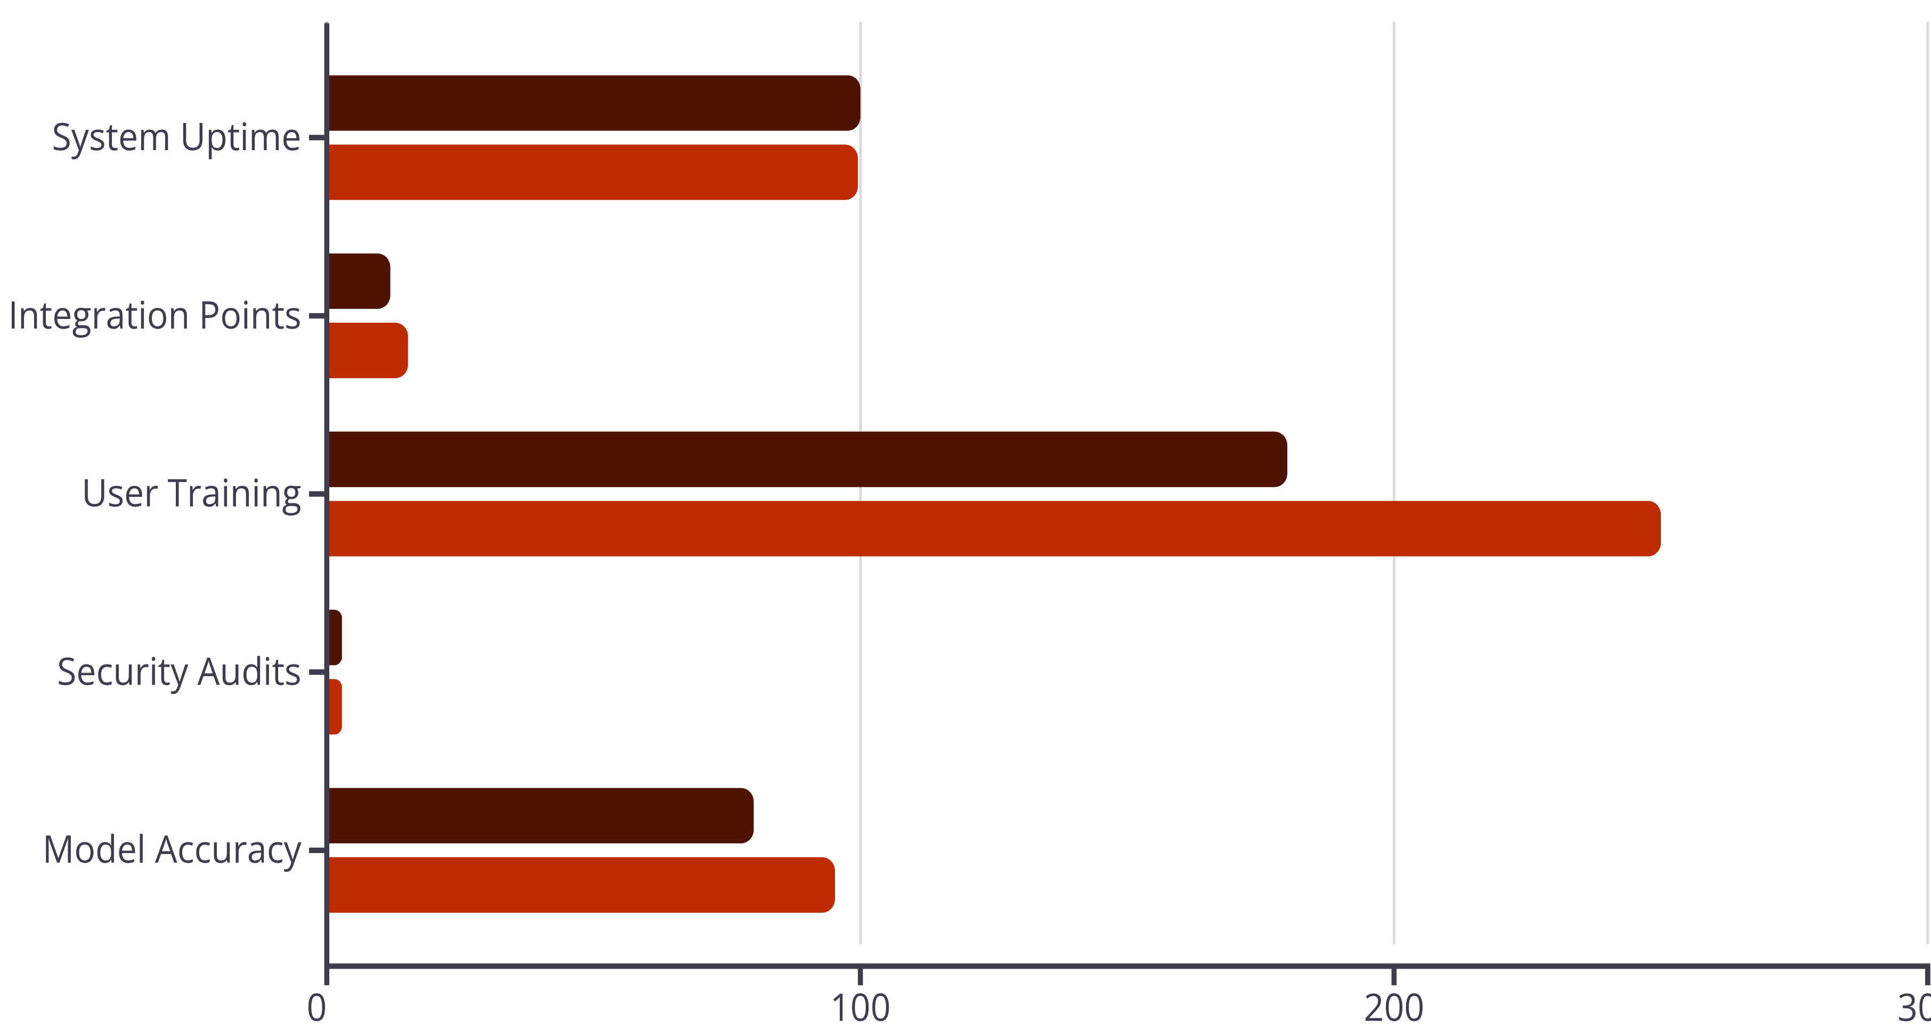
Program Health Dashboard
87%
$8.4M
92%
Schedule Performance
Budget Utilized
Stakeholder Satisfaction
On track for Phase 1 delivery with 2-week buffer remaining
70% of $12M total budget, forecast to complete within 5% variance
Based on monthly surveys across 15 participating government entities
Key Performance Indicators
Current
Target

Slide 9




Governance & Stakeholder Framework
Executive Steering Committee
1
Monthly | Strategic decisions
Program Management Office
2
Weekly | Cross-functional coordination
Technical Working Groups
3
Bi-weekly | Implementation & architecture
Department Implementation Teams
4
Daily standups | Delivery execution
Communication Strategy
Executive leadership receives monthly dashboard reviews with red/yellow/green status indicators. Technical teams participate in daily 15-minute Scrum standups. Government stakeholders receive bi-weekly progress briefings with focus on citizen impact metrics. Change management communications deployed through multiple channels including town halls, newsletters, and dedicated support portal.

Slide 10

Next Steps & Go-Forward Plan
01
02
03
Secure Phase 1 Approvals
Finalize Resource Allocation
Execute Infrastructure Deployment
Obtain executive sign-off on ERP mitigation strategy and hybrid NLP approach by Week 1
Confirm dedicated team assignments across 15 government entities and vendor augmentation by Week 2
Complete cloud environment provisioning and security framework implementation by Month 2
04
05
Initiate Pilot Program
Scale to Production
Launch with 2 pilot departments to validate architecture and refine processes by Month 4
Government-wide rollout following successful pilot validation and executive review by Month 11
Decision Required: Executive approval needed for hybrid NLP deployment strategy and ERP parallel environment approach. Recommendation: Proceed with both solutions to maintain critical timeline while managing risk effectively. Total incremental investment: $580K to protect $12M program and ensure on-time delivery.

